Slide 1

Stock price trend prediction using regression

Slide 2
Ambala Nalini Prabath(2403A54121)
Narige.Rohith(2503A54L01)
Bandi.Sai Charan goud(2403A54111)

Slide 3


01.
Why Regression?
02.
Data Foundations
CONTENTS
03.
05.
Model Mechanics
Live Deployment
04.
06.
Visual Signals
Limits & Upgrades

Slide 4



01
Why Regression?

Slide 5

Forecasting With Regression
Linear regression turns historical price data into a straight-line trend that projects tomorrow’s most likely closing price.
Fast & Transparent
It is fast, transparent, and gives every stakeholder an immediate numeric baseline for risk-return decisions.

Slide 6
Edge Over Gut Feeling
Regression replaces intuition with evidence.
Directional Bias
Fair Value
Risk Range
The slope equals directional bias, providing a clear trend indicator.
The intercept equals fair value, anchoring the forecast to a fundamental level.
Error bands equal the risk range, quantifying uncertainty for objective position sizing.

Slide 7
02
Data Foundations

Slide 8
Curating Clean Price History
Start with dividend-adjusted OHLCV data.
Drop missing dates and normalize for splits.
A robust model requires pristine data. Ensure the model learns true market signals, not data artifacts.
Remove outliers beyond three standard deviations.

Slide 9

Choosing Predictive Features
Engineer features that capture momentum, mean-reversion, and seasonality without overfitting.
Lagged returns & Rolling volatility
20-day & 50-day moving averages
Calendar dummies (Month/Quarter)

Slide 10
03
Model Mechanics

Slide 11
Fitting The Best-Fit Line
Ordinary Least Squares (OLS) minimizes squared errors to yield a clear, actionable equation.
Result
Method
Benefit
Minimize the sum of the squares of the differences between observed and predicted values.
$$y=mx+b$$
An explicit formula for rapid deployment in Excel or Python.
A formula mapping features (X) to the next-day price (y).

Slide 12
Validating Forecast Accuracy
MAE & RMSE
Quantify the average magnitude of errors in the predicted price levels.
Use walk-forward validation to keep the model honest and quantify its performance with key metrics.
Directional Hit-Rate
Walk-Forward Validation
Measure how often the model correctly predicts the up/down movement of the stock.
Simulate real-world conditions by training on past data and testing on unseen future data (e.g., the last 20% of the dataset).

Slide 13
04
Visual Signals

Slide 14
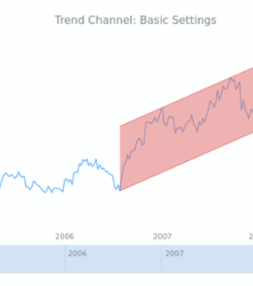
Plotting Regression Channel
Overlay ±2-standard-error bands around the fitted line to create a dynamic channel.
Prices outside the band flag potential reversal points.
Slope color instantly communicates trend strength on any chart.

Slide 15
Reading Slope Shifts Early
Monitor the regression slope for early warnings before classic indicators trigger.
Flattening Slope
Steepening Slope
Warns of momentum loss, signaling a potential trend exhaustion.
Confirms acceleration, indicating a strengthening trend.

Slide 16
05
Live Deployment

Slide 17
From Jupyter To Market
Automate the entire pipeline for a hands-off, daily forecast.
ETL Script
Append & Retrain
Generate Forecast
OMS Integration
Downloads new data
Updates the model
Writes to a CSV file
Consumed by trading systems

Slide 18

Risk Managed Positioning
Embed model confidence directly into capital allocation rules. Size trades by the inverse of the forecast error.
Wider Bands = Smaller Size
High uncertainty demands caution. Reduce position size to manage risk.
Tighter Bands = Larger Size
High conviction allows for greater capital allocation to capitalize on the signal.

Slide 19
06
Limits & Upgrades

Slide 20
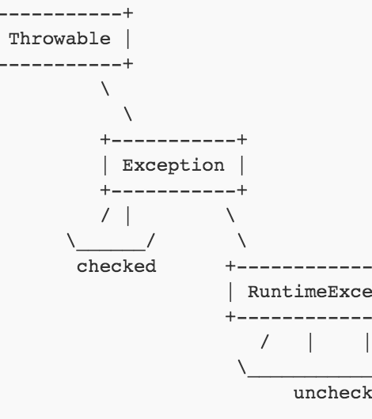
When Linearity Fails
Regime shifts, earnings gaps, or black-swan events break linear assumptions. Be prepared to adapt.
Detect
Monitor for spikes in model residuals as a sign of structural breaks.
Adapt
Switch to more flexible models like regime-switching or LSTM hybrids.

Slide 21
Next-Gen Hybrid Pipeline
Combine regression for interpretability with LSTM for non-linear patterns, creating a powerful, transparent ensemble.
Linear Regression
LSTM Network
LR-LSTM Fusion
Provides an interpretable baseline forecast.
Models the non-linear residuals and complex patterns.
A weighted ensemble that lifts accuracy while preserving transparency.

Slide 22


THANK YOU
Jhh

